Slide 1
19 November 2008 A Canoe Journey Down the River Severn
Lo – To plan a river journey from Source to Mouth

Slide 3
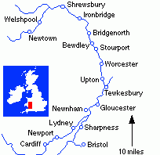

Slide 4
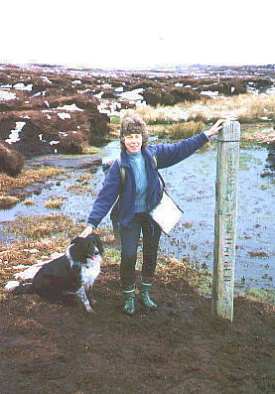
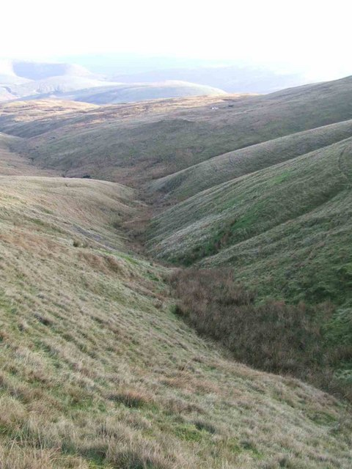
Starts at Plynlimon (Upper Course)

Slide 5
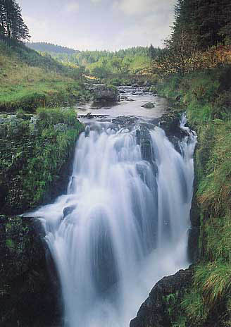
Upper Course Features
Rapids
Waterfalls

Slide 6
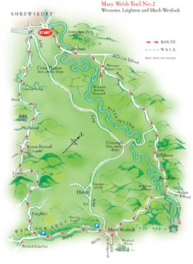
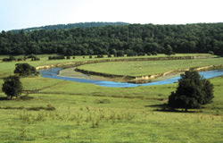
Meanders on the Severn (middle course)

Slide 7
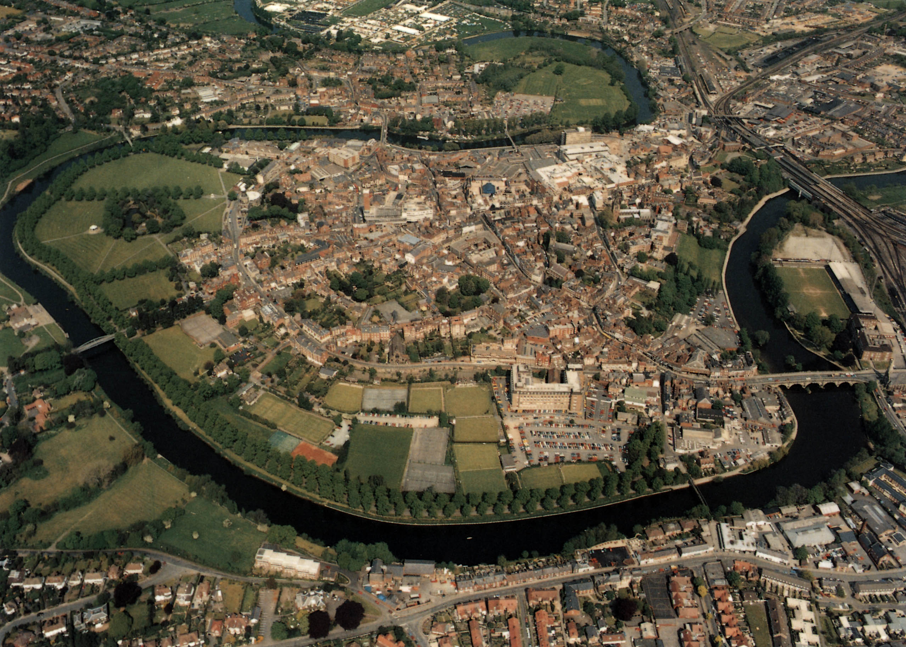
Shrewsbury – in a meander

Slide 8
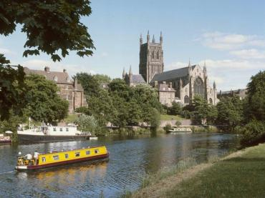
Worcester

Slide 9
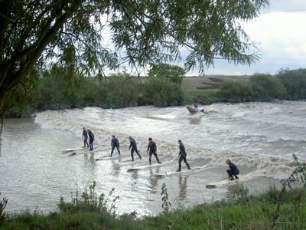
The Severn Bore Wave

Slide 10
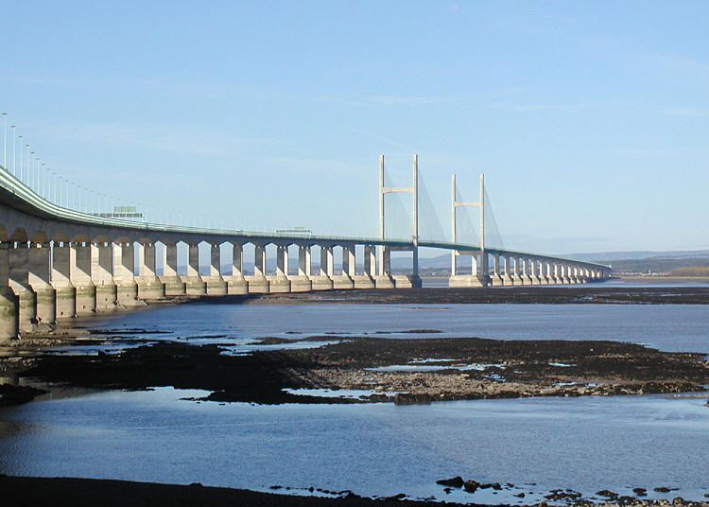
Estuary – the Severn Bridge (lower course)

Slide 11
This powerpoint was kindly donated to www.worldofteaching.com
http://www.worldofteaching.com is home to over a thousand powerpoints submitted by teachers. This is a completely free site and requires no registration. Please visit and I hope it will help in your teaching.

